Slide 1
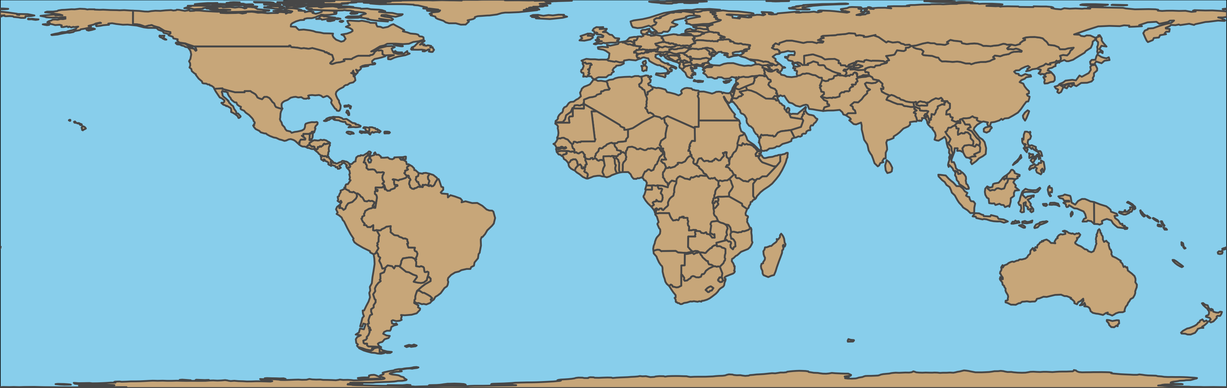
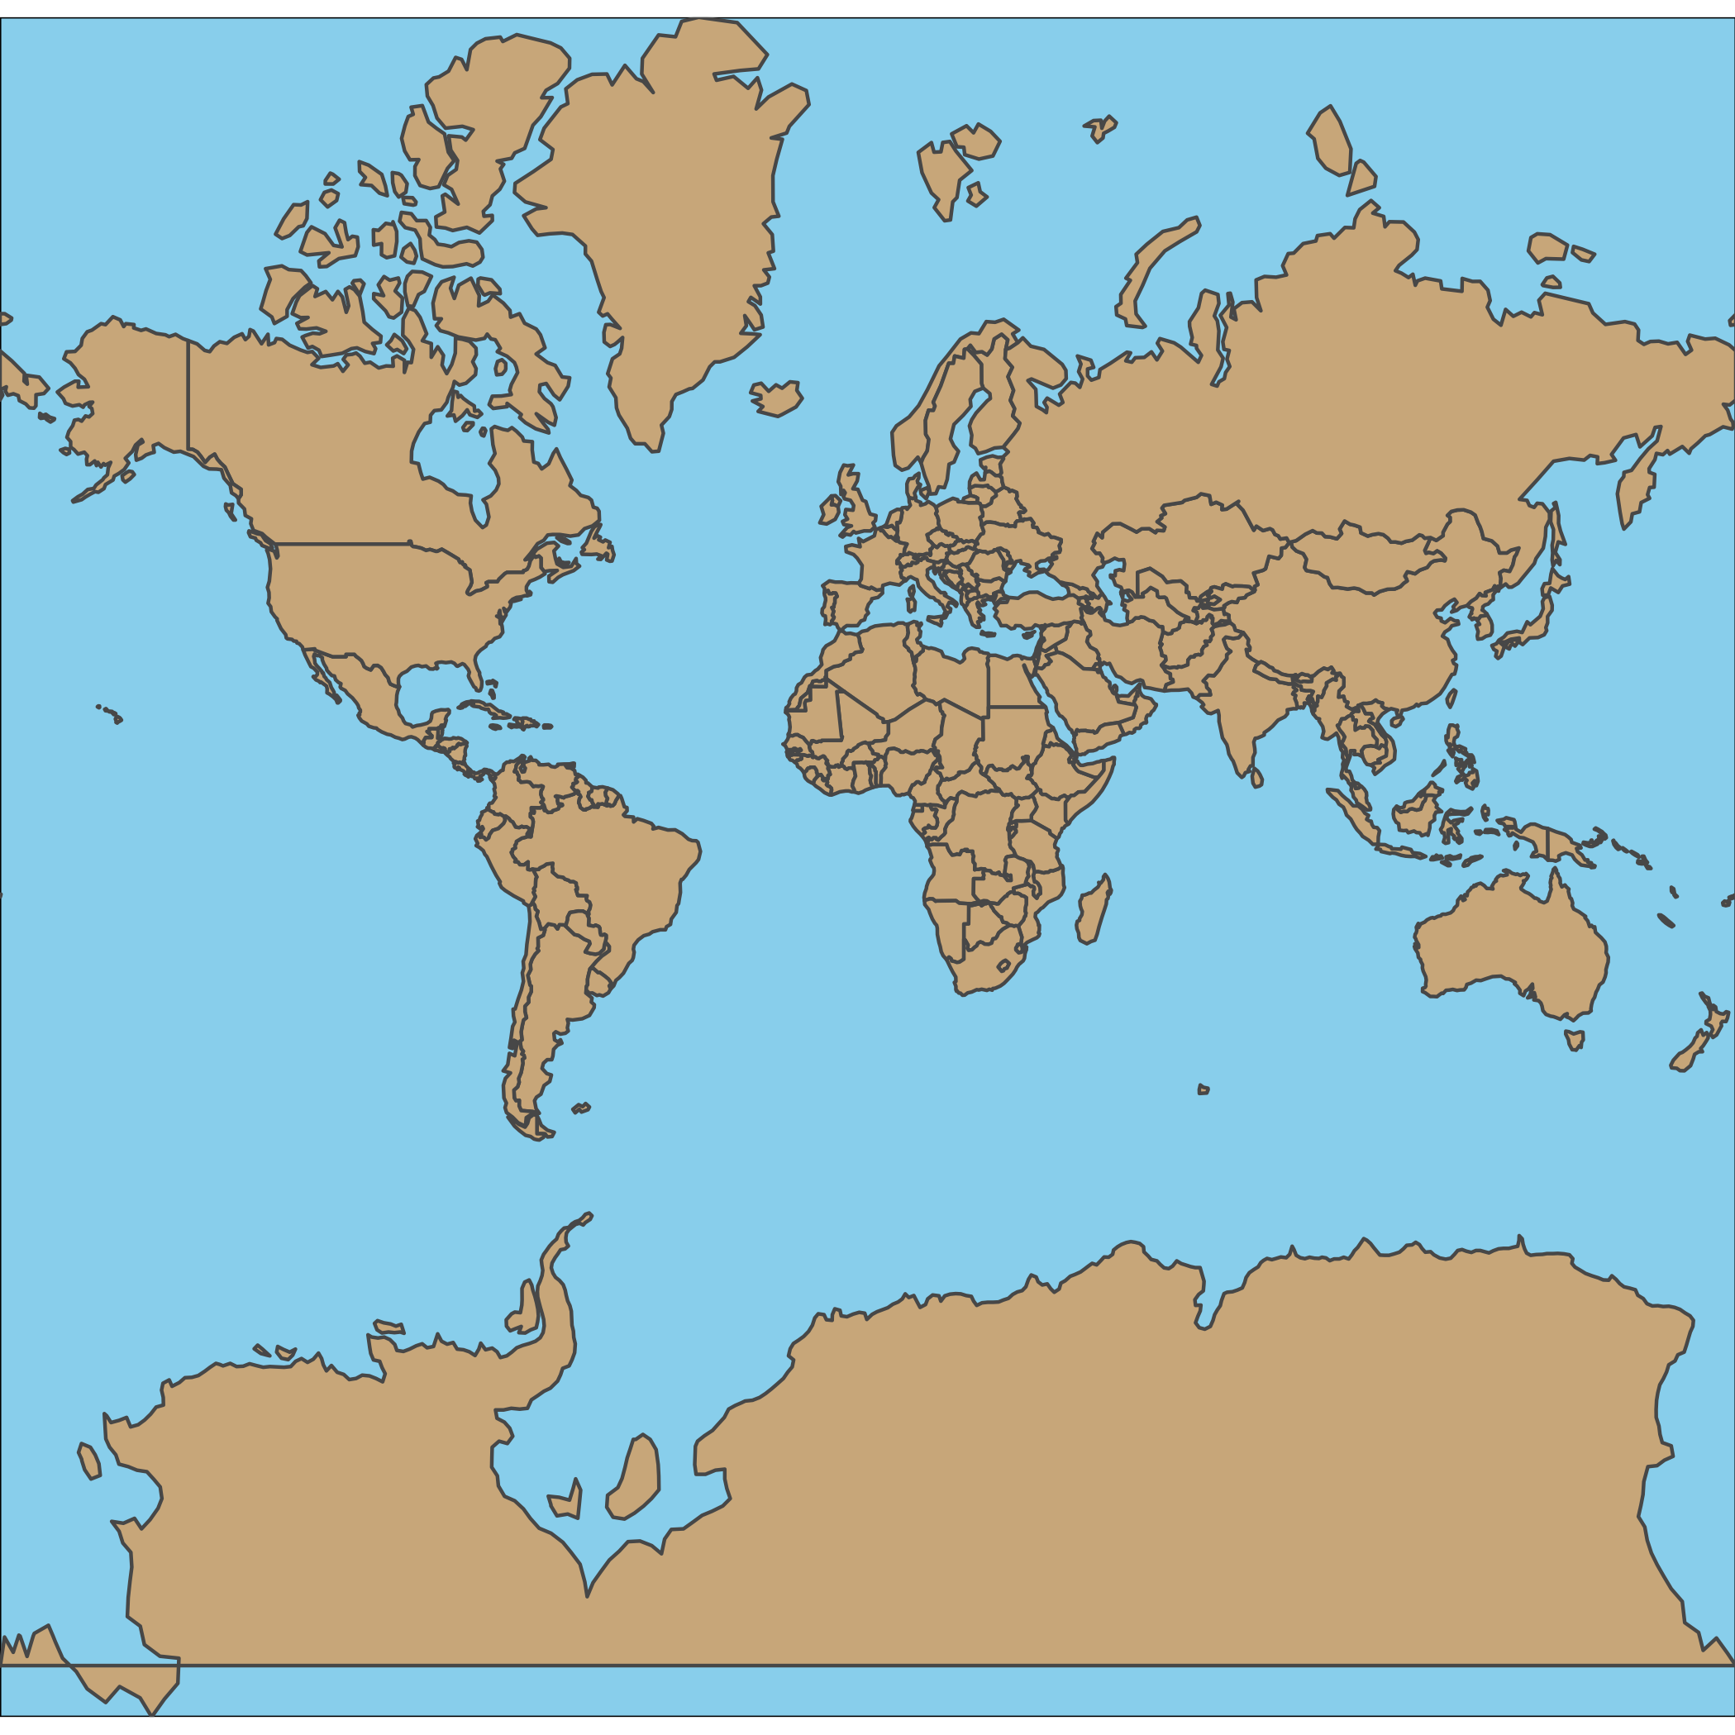
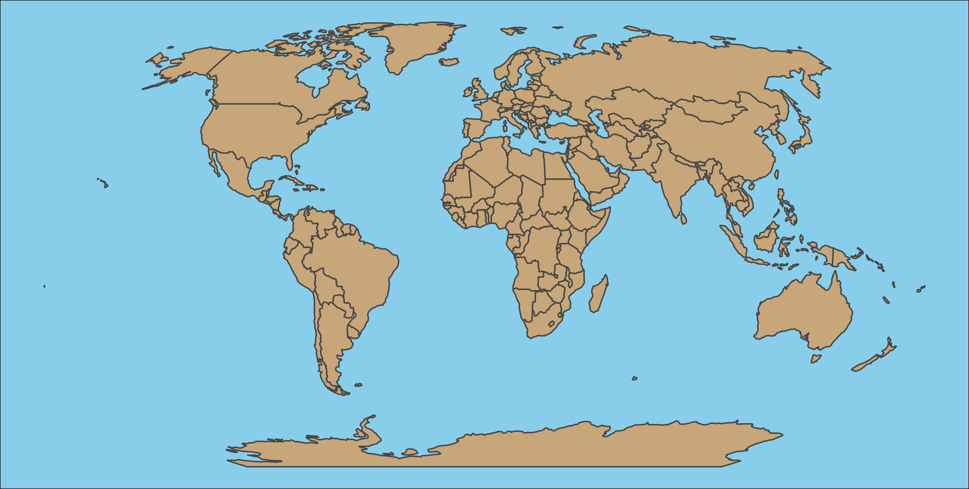

Slide 2
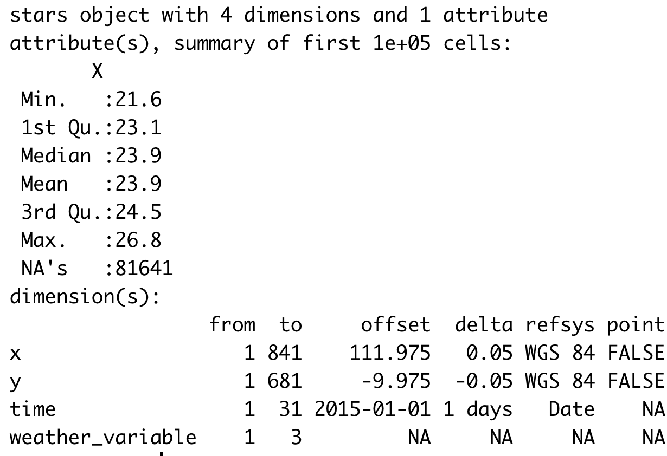

Slide 3
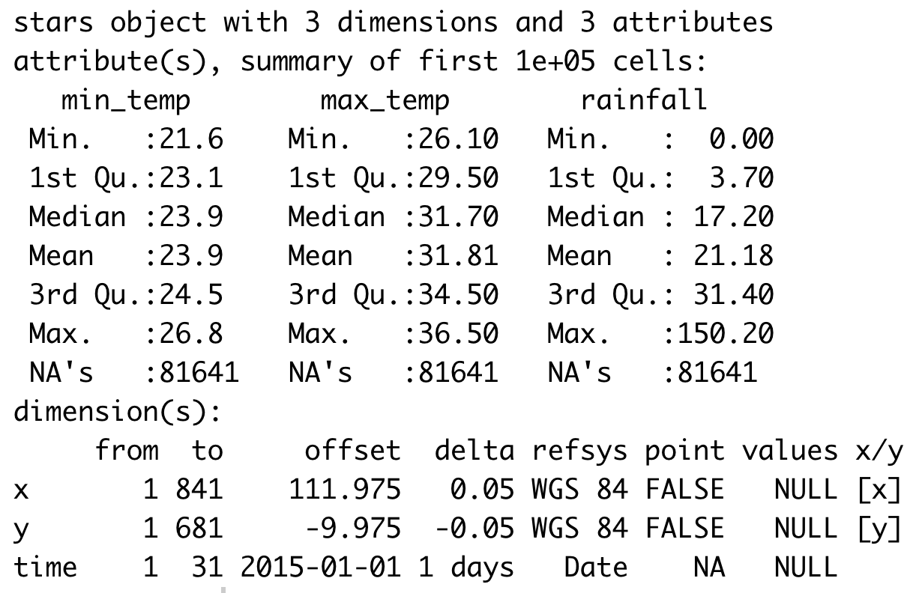

Slide 4


Slide 5
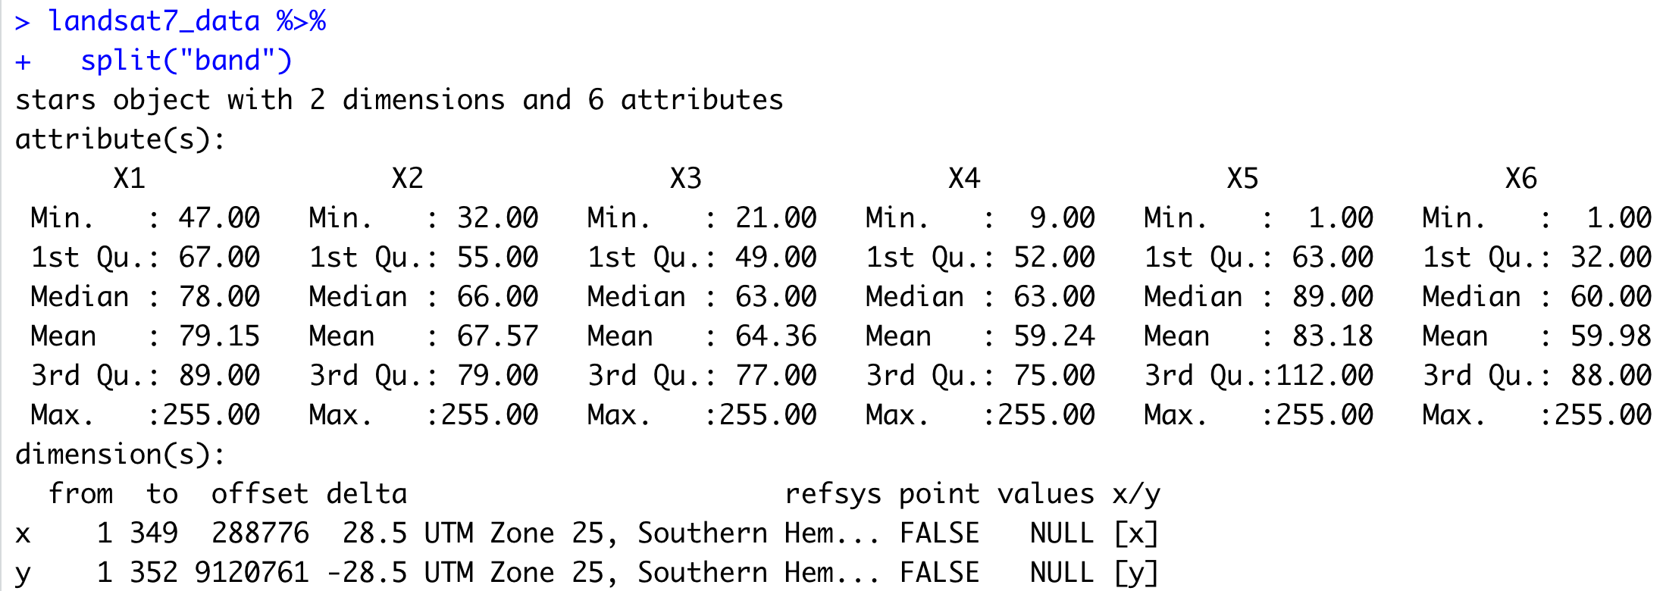

Slide 6
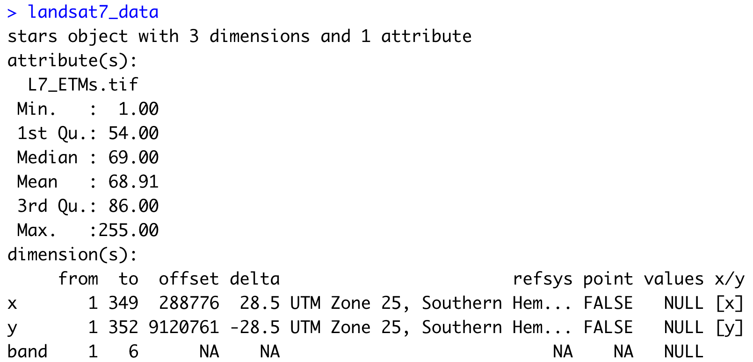

Slide 7
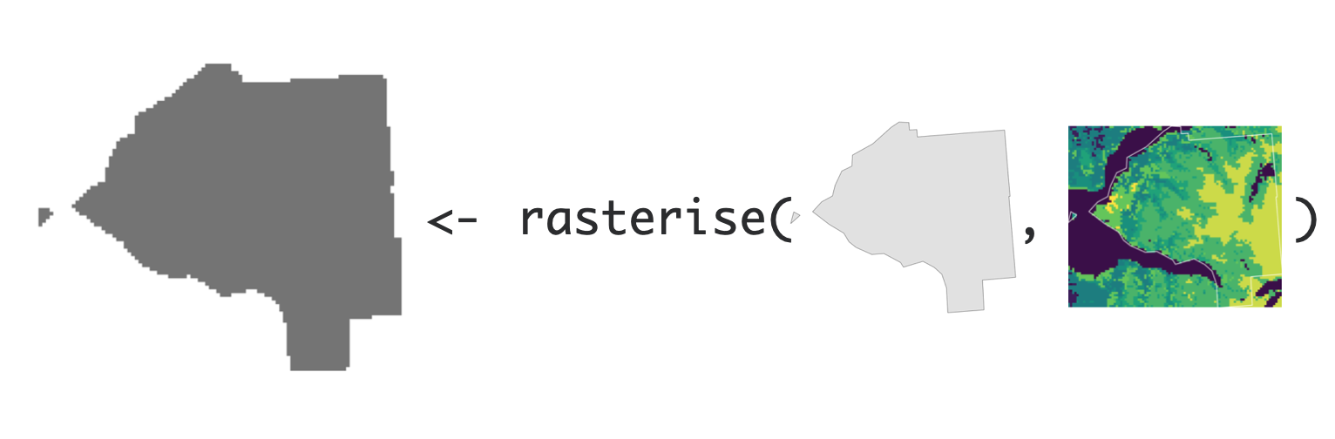
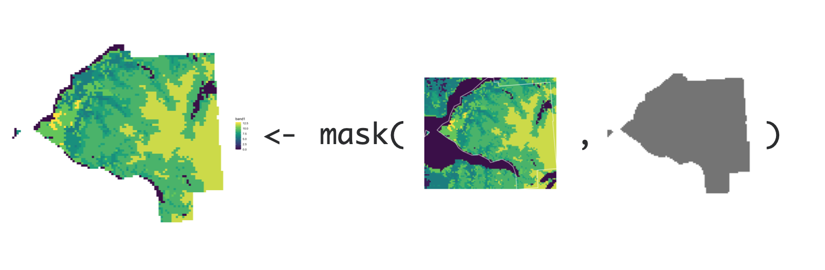

Slide 9



Slide 10


Slide 11








Slide 12
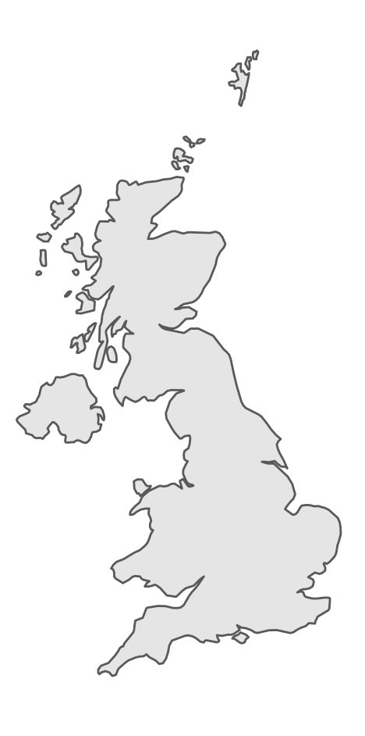
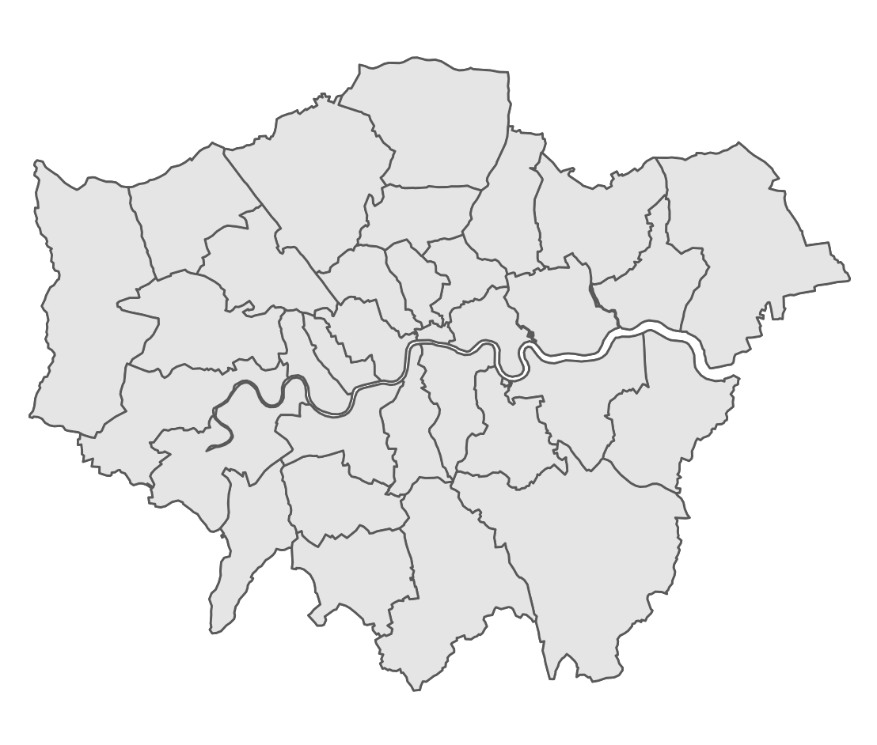
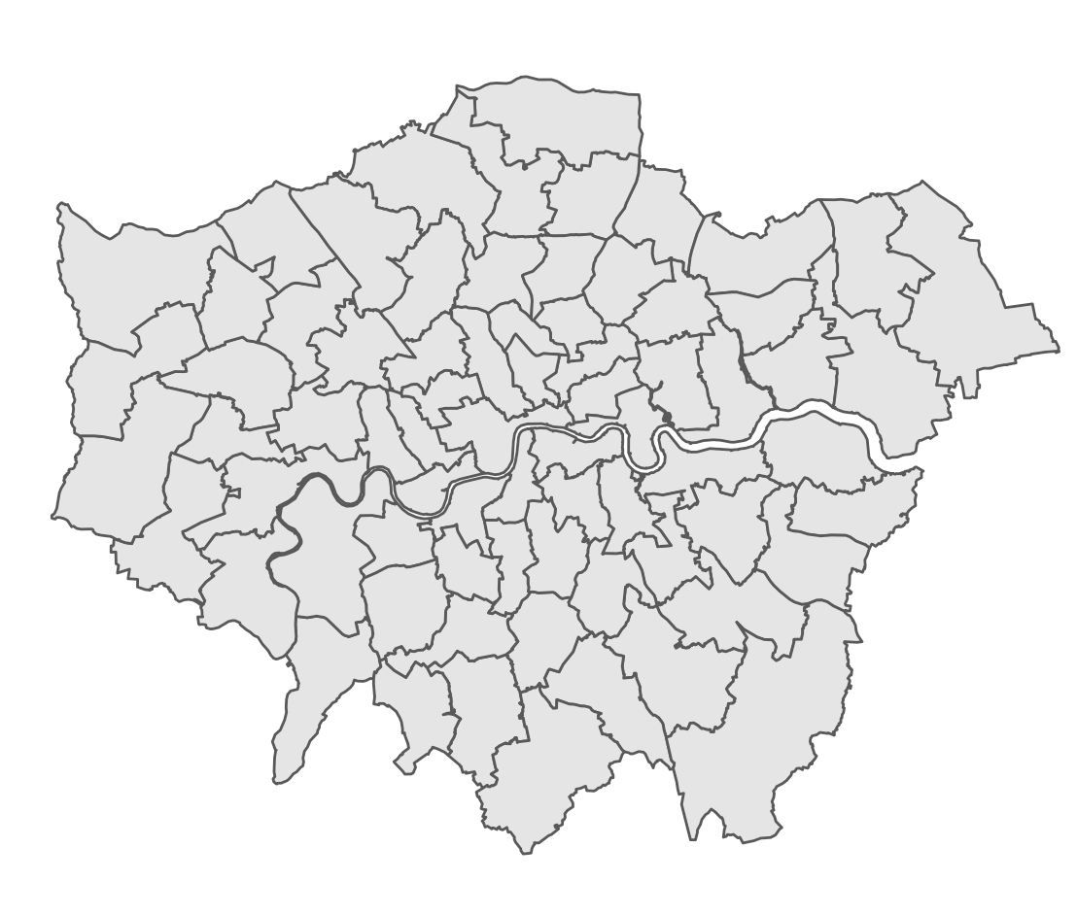
Country borders
Administrative Divisions
Other subunits
(local authorities)
(constituencies)

Slide 13
Country borders
Administrative Divisions
Other subunits
(local authorities)
(constituencies)

Slide 14
Country borders
Administrative Divisions
Other subunits
(local authorities)
(constituencies)

Slide 15
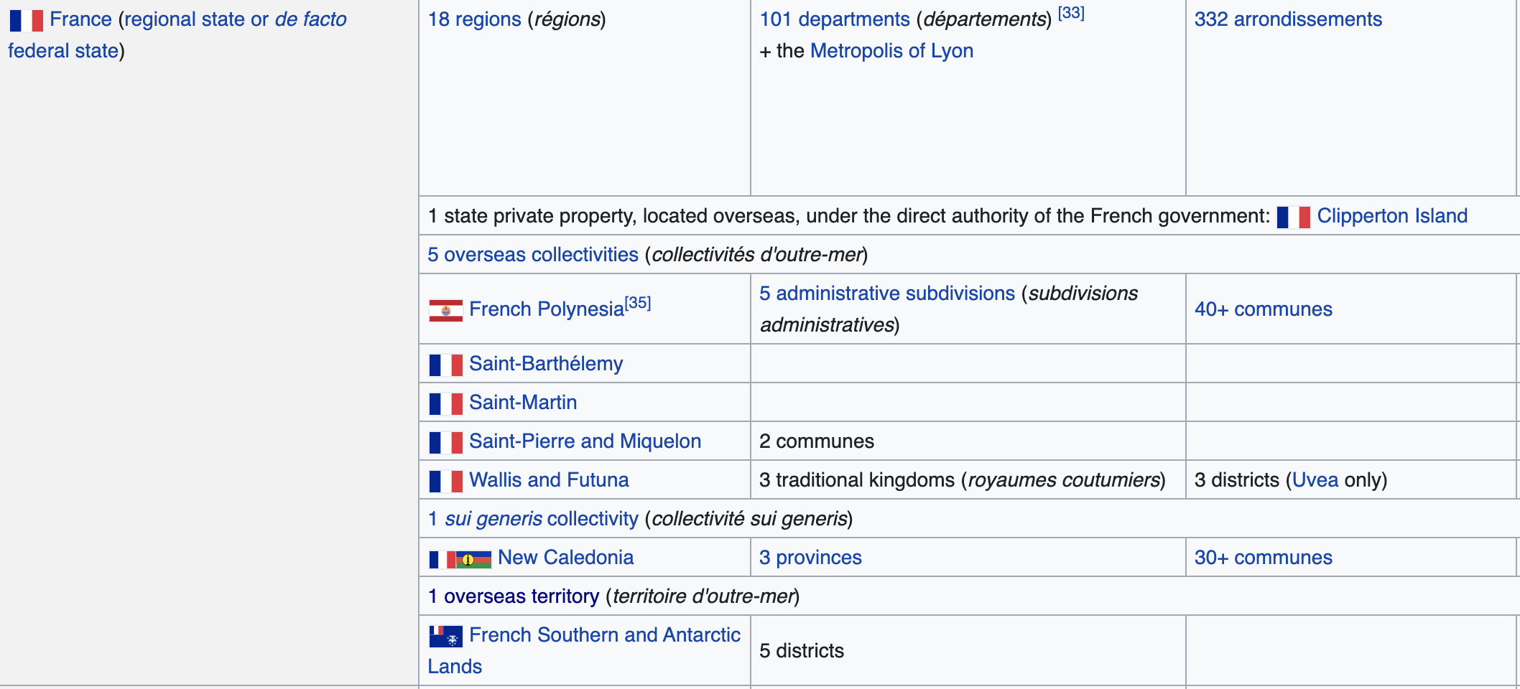

Slide 16
Other subunits
(constituencies)

